Slide 1
FAIR Privacy Factor Analysis in Information Risk (Privacy Version)
Opportunity
The frequency, given time frame, that threat actors interact with individuals or their proxies.
Attempt Frequency
The frequency, given a time frame, that threat actors attempt to threaten the at-risk population given the opportunity and their motivation.
Motivation
The probability that threat actors will seize an opportunity.
Threat Frequency
The frequency, given a time frame, that threat actors threaten the at-risk population.
Capability
The skills and resources available to threat actors in a given situation to act.
Vulnerability
The probability that threat actors’ attempts will succeed.
Privacy Risk
The frequency of privacy threats and magnitude of privacy harms for the at-risk population.
Difficulty
The impediments that a threat actor in a given situation must overcome to act
Severity
The degree to which an activity violates social norms of privacy.
Harm Magnitude
. The severity of the harm in the at risk population and the tangible consequential risks to them.
Adverse Consequence Frequency
Adverse Consequence Risk
The frequency and magnitude of adverse tangible consequences on the threatened population.
Adverse Consequence Magnitude

Slide 2
Privacy Harms Based on Dan Solove’s Taxonomy of Privacy
Non-Information
Collection Surveillance Interrogation
Invasion Intrusion Decisional Interference
Information
Information Processing Aggregation Insecurity Identification Secondary Use Exclusion
Information Dissemination Breach of Confidentiality Disclosure Exposure Increased Accessibility Appropriation
Note you can use other sets of (moral) privacy harms.

Slide 3
Adverse Tangible Consequences
Subjective
Psychological
Embarrassment
Anxiety
Suicide
Behavioral
Changed Behavior
Reclusion
Objective
Lost Opportunity
Employment
Insurance & Benefits
Housing
Education
Economic Loss
Inconvenience
Financial Cost
Social Detriment
Loss of Trust
Ostracism
Loss of Liberty
Bodily Injury
Restriction of Movement
Incarceration
Death

Slide 4
EXAMPLE
Surveillance risk of smart locks by “managers”
This example comes from the paper, “Quantitative Privacy Risk,” published in the proceedings of the 2021 IEEE European Symposium on Privacy and Security. For more detail and exploration see that paper at https://doi.org/10.1109/EuroSPW54576.2021.00043
The provided Excel spreadsheet (v2.11) has more details on the calculations used in this example.

Slide 5

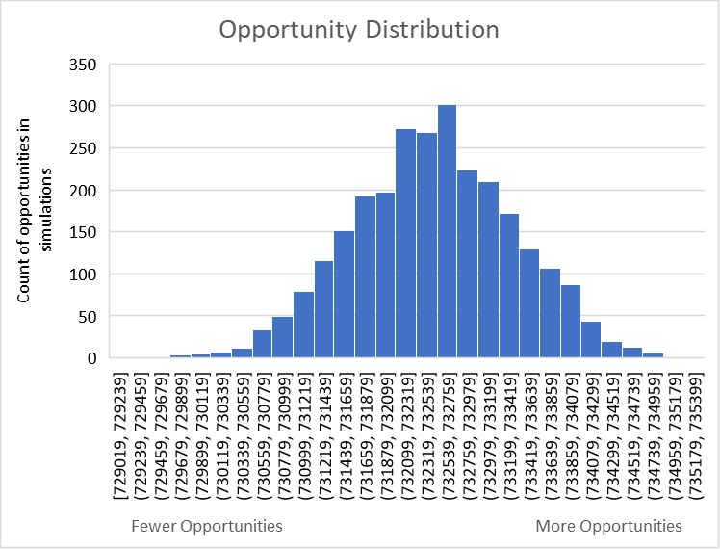
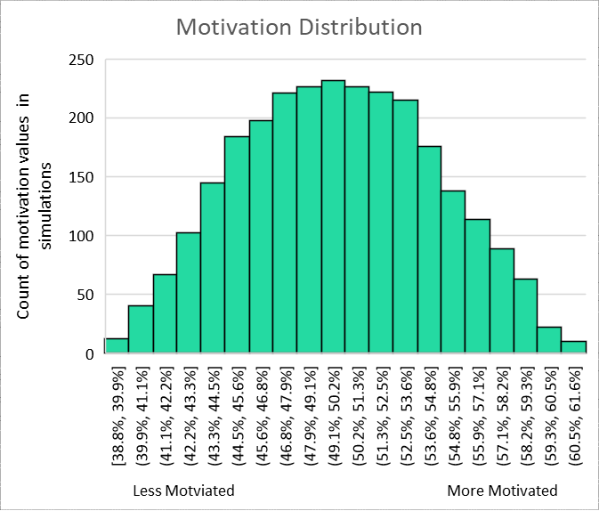
EXAMPLE: Surveillance Risk of Smart Locks
Breakdown by factors
Opportunity
The frequency, given time frame, that threat actors interact with individuals or their proxies.
1 manager × 1.465 occupants × 500, 000 households
= 732, 500 opportunities
Estimate used in Poisson distribution
Motivation
The probability that threat actors will seize an opportunity.
A survey was taken to estimate the motivation of potential “managers” to surveill occupants
Capability
The skills and resources available to threat actors in a given situation to act.
Difficulty
The impediments that a threat actor in a given situation must overcome to act
Without impediments, the capability was presumed to exceed difficulty leading to 100% vulnerability for inherent/baseline risk calculation

Slide 6
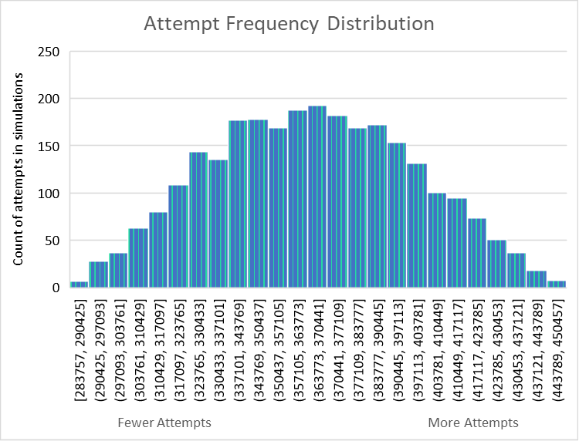
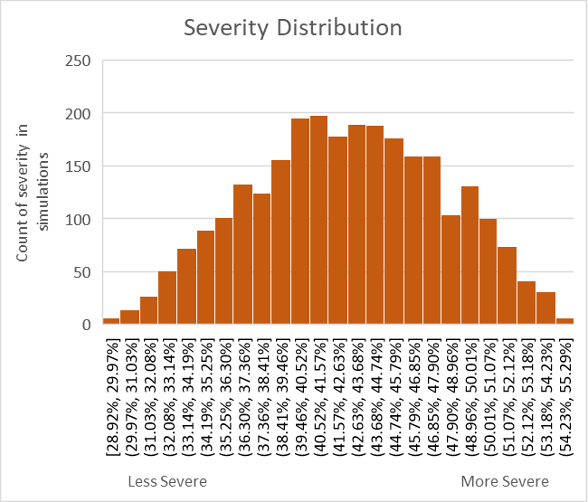
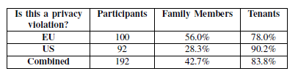
EXAMPLE: Surveillance Risk of Smart Locks
Breakdown by factors
Combined from opportunity and motivation, the attempt frequency distribution looks like the graph at left.
Attempt Frequency
The frequency, given a time frame, that threat actors attempt to threaten the at-risk population given the opportunity and their motivation.
Combined from opportunity and motivation, the attempt frequency distribution looks like the graph at left.
Threat Frequency
The frequency, given a time frame, that threat actors threaten the at-risk population.
100% as threat actor capability exceeded any difficulty.
Vulnerability
The probability that threat actors’ attempts will succeed.
Severity distribution based on survey to determine whether such surveillance exceeded social norms of behavior.
Severity
The degree to which an activity violates social norms of privacy.
Harm Magnitude
. The severity of the harm in the at risk population and the tangible consequential risks to them.
Adverse Consequence Risk
The frequency and magnitude of adverse tangible consequences on the threatened population.
For this exercise tangible consequences were ignored.

Slide 7
EXAMPLE: Surveillance Risk of Smart Locks
Quantification
Measuring privacy risk by itself doesn’t provide much to action on.
Threat Frequency
The frequency, given a time frame, that threat actors threaten the at-risk population.
Privacy Risk
The frequency of privacy threats and magnitude of privacy harms for the at-risk population.
Harm Magnitude
. The severity of the harm in the at risk population and the tangible consequential risks to them.

Slide 8
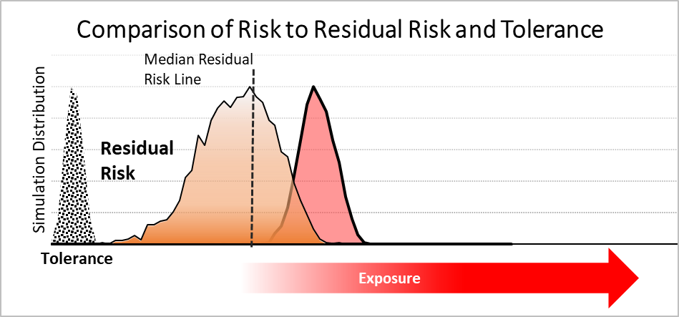
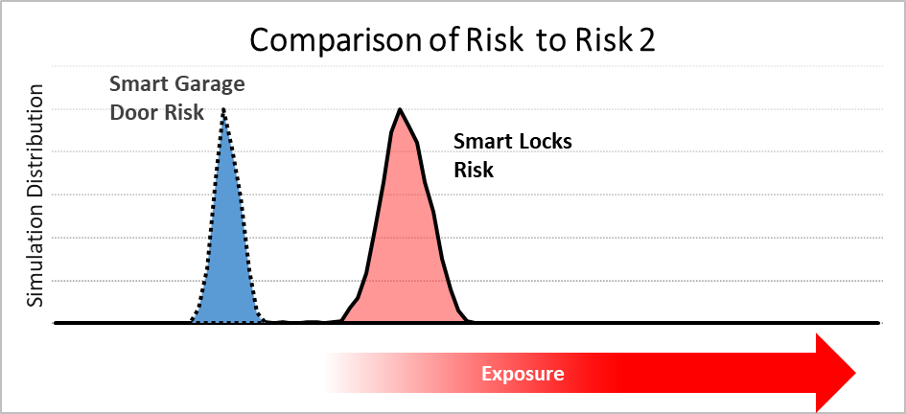
EXAMPLE: Surveillance Risk of Smart Locks
Comparisons
Threat Frequency
The frequency, given a time frame, that threat actors threaten the at-risk population.
Comparing risk to tolerance, residual risk or another risk, can help organization prioritize activities.
Privacy Risk
The frequency of privacy threats and magnitude of privacy harms for the at-risk population.
Harm Magnitude
. The severity of the harm in the at risk population and the tangible consequential risks to them.

Slide 9
Resources
R. J. Cronk and S. S. Shapiro, "Quantitative Privacy Risk Analysis," 2021 IEEE European Symposium on Security and Privacy Workshops (EuroS&PW), 2021, pp. 340-350, doi: 10.1109/EuroSPW54576.2021.00043.
R. Jason Cronk, “Analyzing Privacy Risk Using FAIR” (Jan 14, 2019) FAIR Institute https://www.fairinstitute.org/blog/analyzing-privacy-risk-using-fair
FAIR Institute
R. Jason Cronk, “Why privacy risk analysis must not be harm focused” (Jan 15, 2019) IAPP https://iapp.org/news/a/why-privacy-risk-analysis-must-not-be-harm-focused/
EXTRA
Jaap-Henk Hoepman, Privacy Design Strategies, Jan 2019
Dan Solove, A Taxonomy of Privacy, Jan 2006, UPenn Law Review

